Slide 1
RATHINAM
CENTRE OF EXCELLENCE
Database Management System
UML Diagrams
by
Mrs.B.Sharmila
Technical trainer

Slide 2
Introduction to UML Diagrams
UML stands for Unified Modelling Language.
UML is a pictorial language used to make software blueprints.
UML is a standard language for specifying, visualizing, constructing, and documenting the artifacts of software systems.

Slide 3
Introduction to UML Diagrams
As UML describes the real-time systems, it is very important to make a conceptual model and then proceed gradually.
The conceptual model of UML can be mastered by learning the following three major elements −
UML building blocks
Rules to connect the building blocks
Common mechanisms of UML

Slide 4
Building blocks of UML
The building blocks of UML can be defined as −
Things
Relationships
Diagrams

Slide 5
Things
Things are the most important building blocks of UML. Things can be −
Structural
Behavioral
Grouping
Annotational

Slide 6

Structural things in UML
Structural things define the static part of the model. They represent the physical and conceptual elements.
Following are the brief descriptions of the structural things.
Class − Class represents a set of objects having similar responsibilities.

Slide 7


Structural things in UML
Interface − Interface defines a set of operations, which specify the responsibility of a class.
Collaboration −Collaboration defines an interaction between elements.

Slide 8



Structural Things
Use case −Use case represents a set of actions performed by a system for a specific goal.
Component −Component describes the physical part of a system.
Node − A node can be defined as a physical element that exists at run time.

Slide 9


Behavioural Things
A behavioral thing consists of the dynamic parts of UML models.
Following are the behavioral things
Interaction − Interaction is defined as a behavior that consists of a group of messages exchanged among elements to accomplish a specific task.
State machine − State machine is useful when the state of an object in its life cycle is important.
It defines the sequence of states an object goes through in response to events.
Events are external factors responsible for state change

Slide 10

Grouping Things
Grouping things can be defined as a mechanism to group elements of a UML model together. There is only one grouping thing available ,
Package − Package is the only one grouping thing available for gathering structural and behavioral things.

Slide 11

Annotational Things
Annotational things can be defined as a mechanism to capture remarks, descriptions, and comments of UML model elements.
Note - It is the only one Annotational thing available. A note is used to render comments, constraints, etc. of an UML element.

Slide 12


Relationship in UML
Relationship is another most important building block of UML. It shows how the elements are associated with each other and this association describes the functionality of an application.
There are four kinds of relationships available.
Association - Association is basically a set of links that connects the elements of a UML model. It also describes how many objects are taking part in that relationship.
Generalization - Generalization can be defined as a relationship which connects a specialized element with a generalized element. It basically describes the inheritance relationship in the world of objects.

Slide 13
UML Diagrams
The visual effect of the UML diagram is the most important part of the entire process. All the other elements are used to make it complete.
UML includes the following diagrams,
Class Diagram
Use case diagram
Activity diagram
Sequence diagram

Slide 14
UML Class Diagrams
UML Class Diagrams → Classes + relationships
Uml Class diagram is similar to a flowchart in which classes are represented as boxes with three rectangles inside each box.
A class diagram also depicts a class’s attributes and operations, as well as the system’s limitations.
Name
Attributes
Methods

Slide 15
Basic Symbols and relationships used in UML Class Diagrams
UML Class Diagrams Main Components
Name
Attributes
Methods
The class name appears in the upper portion. Whether you’re talking about the classifier or an object, this portion is always essential.
The class’s attributes are found in the middle portion
the Class operations are included in the bottom part (methods).

Slide 16
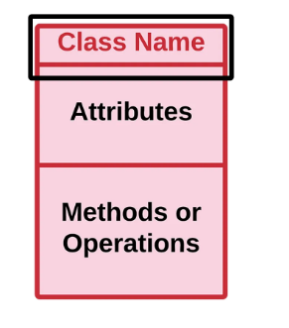
UML Class Diagrams - Class Name
The name of the class is written in the top compartment. The initial letter is capitalized and printed in bold and centered.

Slide 17
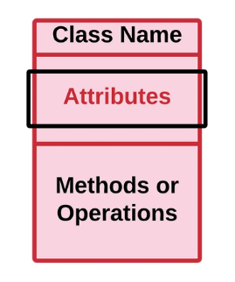
UML Class Diagrams - Attributes
Attributes are used to describe the structure and value of a class instance.
It contains the values that describes each instances.
This section is used to describe the class’s characteristics.
When specifying a specific instance of a class, this is required. It can be represented by fields, variables and properties.

Slide 18
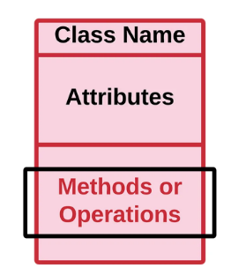
UML Class Diagrams - Methods
Methods in UML Class Diagram is also known as operations or functions.
It allows you to specify any behavioral feature of a class.

Slide 19
UML Class Diagrams Visibility and their Symbols
Private (-)
Public (+)
Protected (#)
Tilde (~)

Slide 20
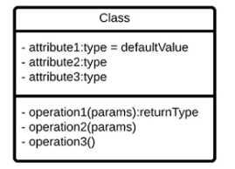
UML Class Diagrams - Private Access Specifier
This UML Class diagram visibility is represented by a minus (-) symbol.
This visibility symbol can’t be accessed by any other class or subclasses.
Here’s the UML Class Diagram example format for the private visibility.

Slide 21

UML Class Diagrams - Public Access Specifier
The public visibility is represented by a plus (+) symbol.
It can be accessed by any other class or subclasses.
And its example UML Class Diagram format is here:

Slide 22
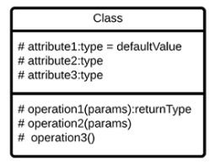
UML Class Diagrams - Protected Access Specifier
Protected: It is one of the class diagram visibility that can be accessed the same class or subclasses.
it is represented by the hash (#) symbol.
We also provided here the example format for UML Class Diagram Protected Visibility.

Slide 23
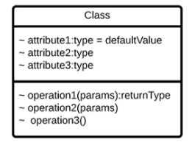
UML Class Diagrams - Tilde Access Specifier
Tilde: The Tilde visibility symbol means that the class can be used as long as its in the same package.
It is represented by this (~) symbol.
And this is the example UML Class Diagram format for it.

Slide 24
UML Class Diagrams - Relationships
Inheritance
Association
Aggregation
Composition

Slide 25
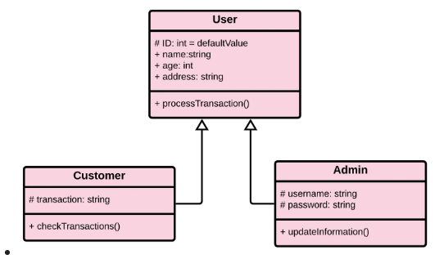
Inheritance
This UML Class Diagram Relationship is used instead of duplicating the attributes to apply them for the subclasses.
The attributes of the superclass or the parent class is used into its subclasses.
And here is the example formation when applying the UML Class Diagram Inheritance.

Slide 26
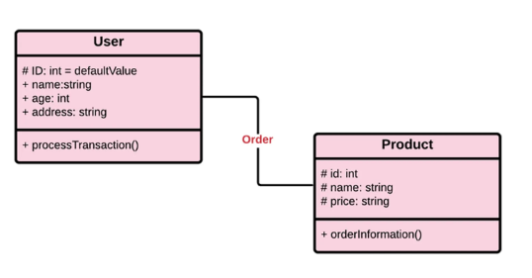
Association
The Association uses a simple line between two classes to emphasize the UML Class Diagram relationship.
Only Association ,no dependency between classes

Slide 27
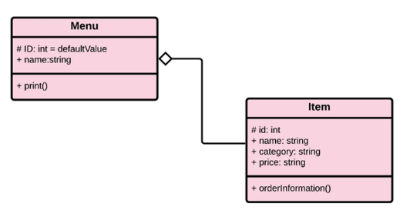
Aggregation
This UML Class Diagram Relationship uses an open diamond symbol.
It is a special type of relationship that specifies a whole and its parts.
Aggregation conveys that a class or a subclass can exist outside a whole.

Slide 28
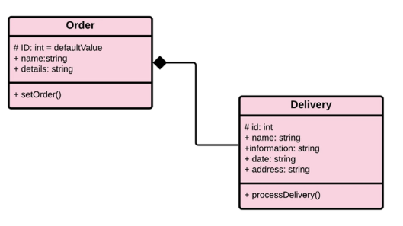
Composition
While the aggregation relationship can exist outside a whole, the Composition can’t.
That is because, every class or subclasses is composed of another class.
In short, they can’t function without the other/s.

Slide 29
Types Of Multiplicity
– Zero to one (0…1) – optional
– N (n) - that a number needs to be specified.
– Zero to many (0…*) - that the multiplicity can be zero up to multiple.
– One to many (0…*) - that the multiplicity can be multiple but the base number must not equal to zero.
– M to N (m…n) - that you must specify the number form the start up to end. It is applicable for loop methods.

